Slide 1
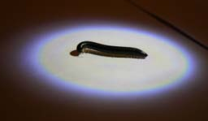
Reducing the migration of P. Millipedes into an urban setting
September 2011
By Kathrine Goldsmith and Simeon Kendall

Slide 2
Why????
Why a “millipede talk” at a waste conference
We are a waste facility that accepts green waste and indirectly accepting problems
Consultation with our neighbours –as we impact on our neighbours
Large mitigation program – usually millipedes are mostly tolerated.

Slide 3
Contents
Millipede
Problem
MRC
Plan of attack
Results
Way Forward

Slide 4
Millipedes
Nuisance pest leaving odour & stains
No natural enemies/not poisonous - so invade buildings in large numbers following rain
Eat decaying organic matter
Arthropod, external skeleton
No waxy coat – dry out
quickly, heat kills
Summer - borrow down into the soil
Positively Phototactic (attached to light)
Nocturnal

Slide 5
P. Millipede Life Cycle
Lay eggs in Autumn – 200-300
Move 100m per year from breeding ground
Live and breed in undisturbed soil & organic matter
Black millipedes – around 2 years old
Brown millipedes – juveniles
Live to around 10 years old

Slide 6
Perth Distribution
1953 - discovered in South Australia
1986 - reached WA
Wide spread problem - across Perth Suburbs
August 2008 - Kinross complaints
Portuguese Millipedes reported in suburbs coloured green
Darker the colour higher infestation

Slide 7
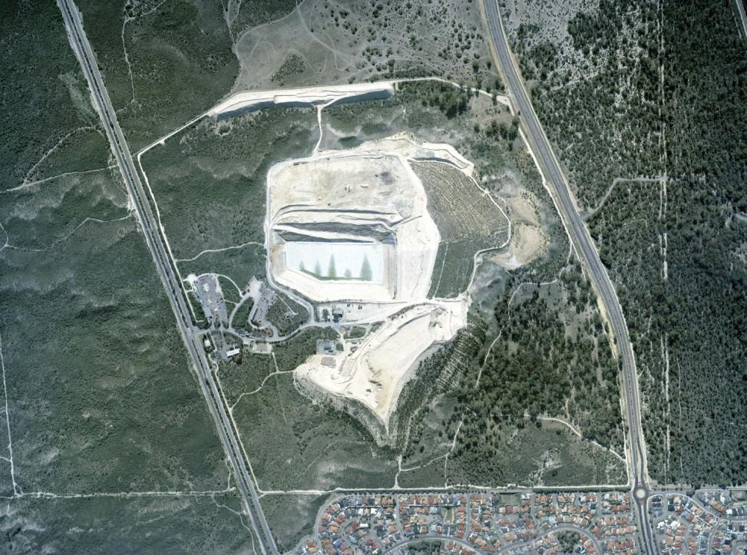
Tamala Park – snap shot
DEC Landfill 1991
157 Ha
Bush Forever site
Aboriginal Sites
Receive up 350,000 tonne of waste per year
ISO 14001 accredited
EMMP – 27 Environmental Plans
Weekly Environmental Inspections

Slide 8
MRC introduction to Millipedes
It has been suggested that household green waste brought in the millipede
Up until 2005 –green waste was processed at Tamala Park
2005 onwards – room needed for stockpile
2008 - April received first Millipede complaint from Kinross

Slide 9
Millipede Time Line
During Winter of 2008 and 2009 complaints increased
(bathrooms, kitchens, outside walls, pathways)
2009 – MRC conducted a Kinross Millipede Survey
247 homes visited - 117 surveyed, 65 with millipede problem, 52 without
65/20 major millipede problem
19 participated in water/light trap trial
53 (not home – letter/brochure left)

Slide 10
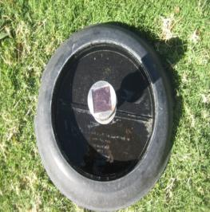
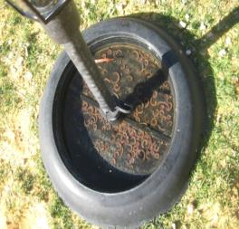
2009 - MRC Plan
Provided Kinross residents with:
Dept of Agriculture Garden Note - P. Millipedes
MRC leaflet – “Operation Millipede” describing planned programs
Chemical spray on boundary (only on boundary, no Bush Forever land)
Providing powered water/light traps
Millipedes positively phototactic

Slide 11
April 2010 – Kinross Resident Meeting
Kinross Residential Assoc. (KRA) held meeting
MRC, CoJ, CoW, Dept. Agric. & Kinross residents
Sharing of information, plan of attack
MRC – Nematode trials, provide water/light traps, commence barrier trials
CoJ – organise the under storey clearing on verge
Western Power – change street lights over to Sodium Luminaries lights
Kinross residents – turn off outside lights, install light/water traps & reduce organic matter close to house if possible

Slide 12
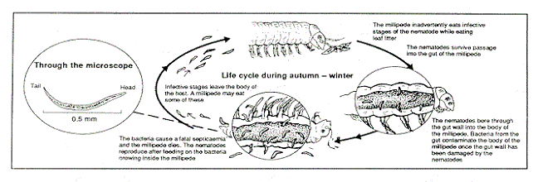
Why – Nematodes
Natural biological control
Ingested by Millipede as they eating organic matter
perforate the gut, Millipede dies and bacteria from gut multiplies
Eats the bacteria and breeds
Young feed on Millipede also – re-infest Millipede

Slide 13
Why – Nematodes ?
Nematodes (Rhabditis necromena)
Naturally occurring, only attaches P. Millipedes
Active Autumn and Winter – like Millipedes.
2-3 years to make a significant effect to Millipede population
Sourced from South Australia

Slide 14
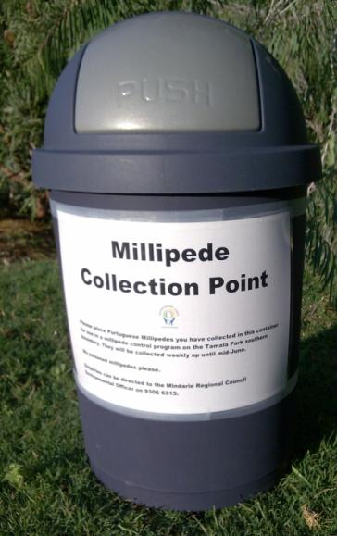
Nematode trail – Biological Control
Nematodes were sourced in July 2009
Nematode stations were located in Kinross so residents could put millipedes in the bins.
Needed to collect 10,000 millipedes
Millipedes will be infested with nematodes and released into the bushland near southern boundary

Slide 15
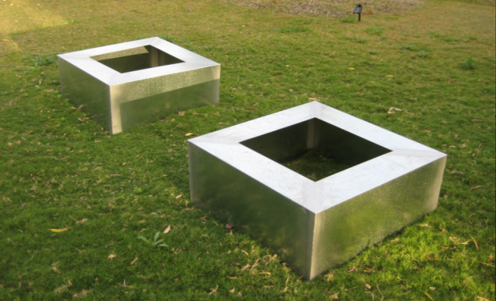
Physical Barrier Trial
Two galvanised boxes were fabricated to capture and hold millipedes
95% success rate
however 5% still escaped

Slide 16
Physical Barrier modifications
0200mm
0.2m
60⁰
60°
0.75mm – 1mm thick
Galvanized Sheeting
400mm
0.4m
Ground level

Slide 17
Installation of Barrier

Slide 18
Tamala Park
Stage 1 – Physical Barrier Trial, July 2010 (200 m section of the worst effected area)

Slide 19
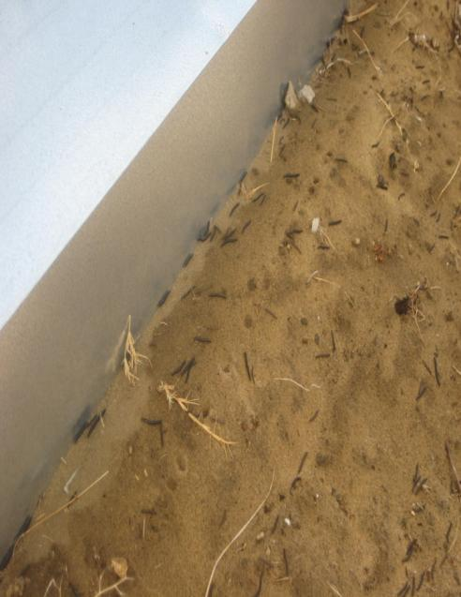
Results of Barrier

Slide 20
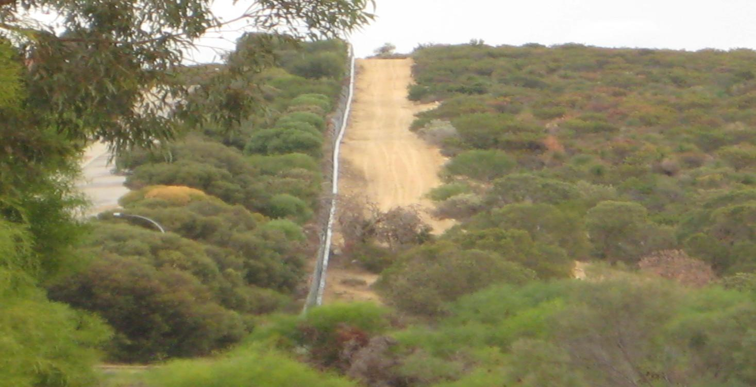
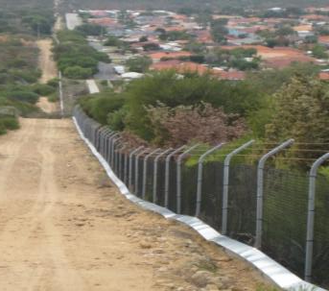
984m later – Barrier completed May 2011

Slide 21
plus 30 Light Traps
Millipede are being attracted to the light source and drowning
Lights are also capturing the juveniles
Gap of vegetation between the barrier and bushland therefore hide up in the bend of the sheeting
No complaints since barrier – we have had a wet winter

Slide 22
Other Stakeholders
City of Joondalup
organise the under storey clearing on verge
Western Power
to change the street lights over to Sodium Luminaries lights
Kinross residents
turn off outside lights
install light/water traps
reduce organic matter close to house, if possible

Slide 23
Net Result/Way Forward
Physical barrier - 1km installation
Remove Light/water traps at the end of winter 2011
Nematodes possibly reducing numbers
Reduced the attraction for Millipede to migrate to Kinross (understorey, breeding ground, light sources)
Way forward –
Ongoing community consultation (via website, KRA)
Maintenance of barrier and Kinross verges/homes

Slide 24
Questions?

